Slide 1
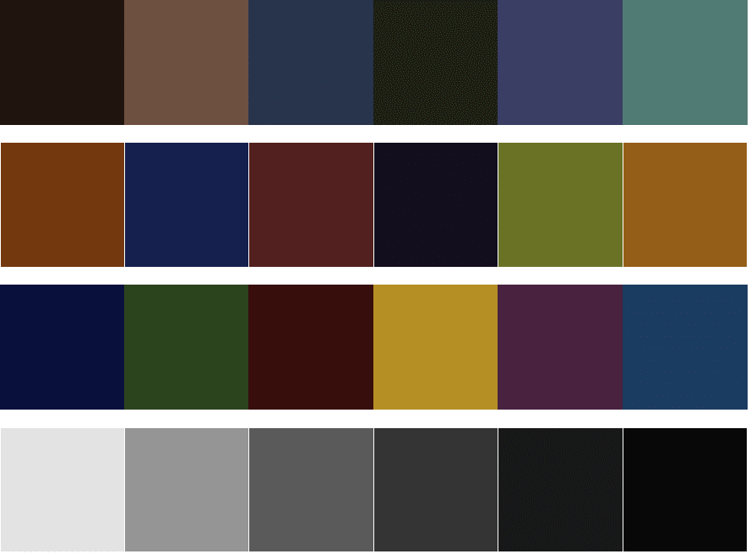
Color illuminant F1

Slide 2
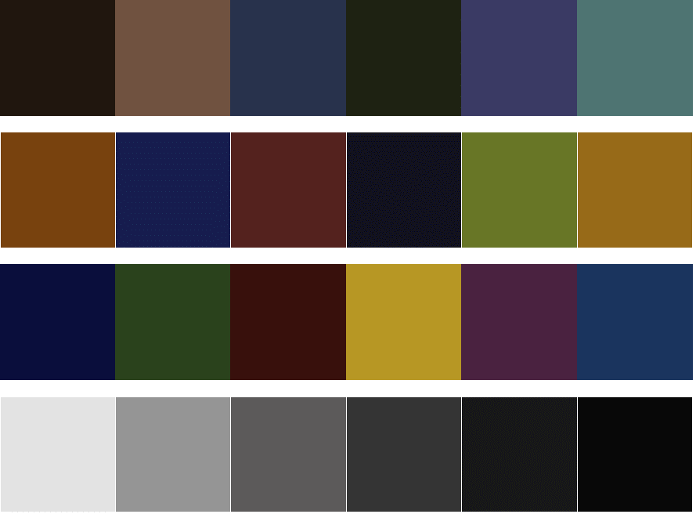
Color illuminant F2

Slide 3
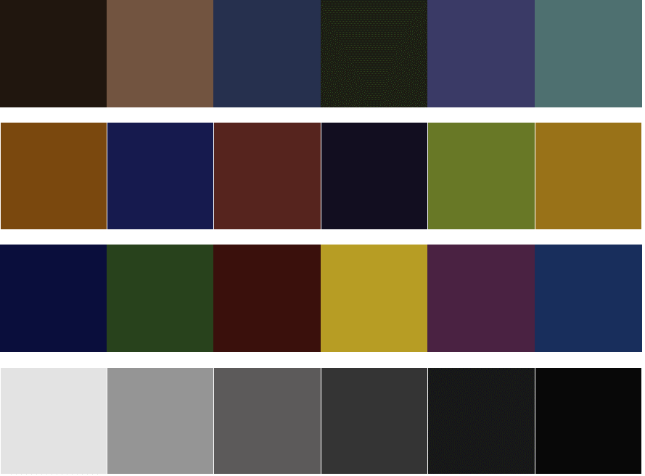
Color illuminant F3

Slide 4
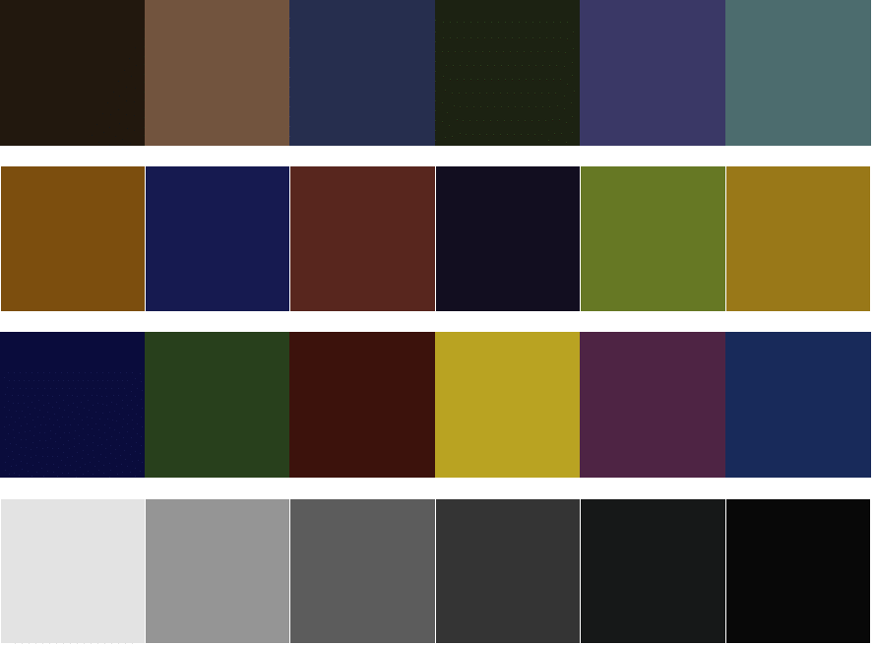
Color illuminant F4

Slide 5
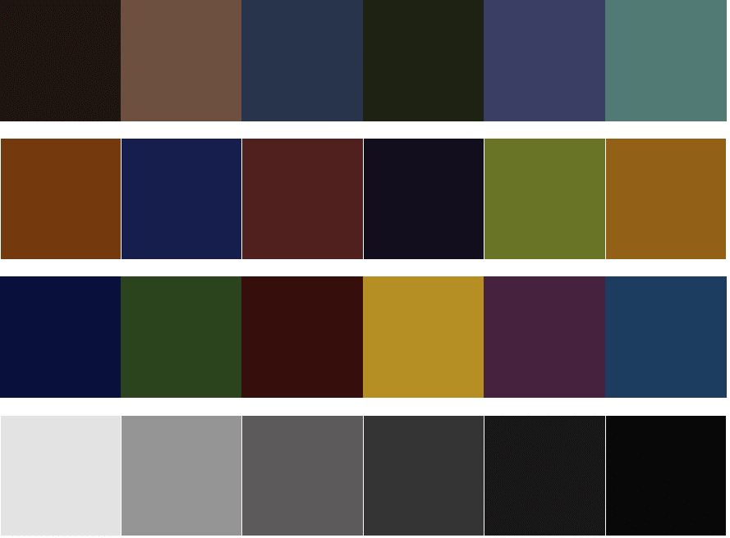
Color illuminant F5

Slide 6

Color illuminant F6

Slide 7

High color rendering illuminant F7

Slide 8
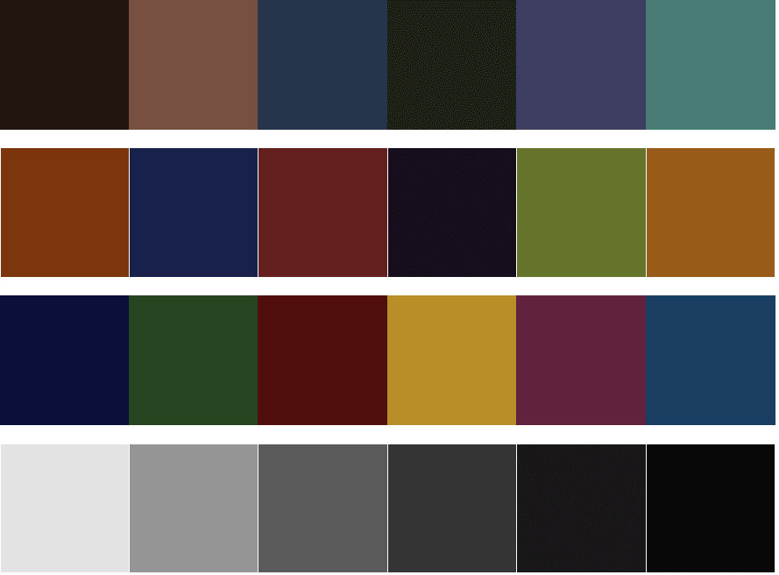
High color rendering illuminant F8

Slide 9

High color rendering illuminant F9

Slide 10

Three band illuminant F10

Slide 11
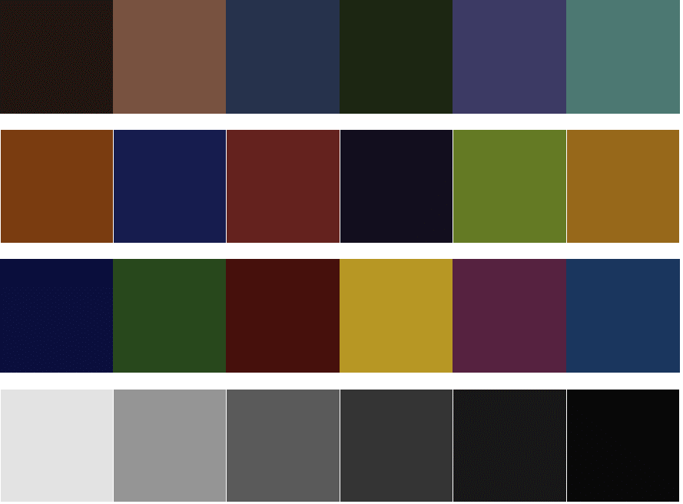
Three band illuminant F11

Slide 12

Three band illuminant F12

